Slide 1




Online Outreach
James Hannan, Clare Lauwerys, Ian Lauwerys
@northessexastro
ü
www.northessexastro.co.uk

Slide 2
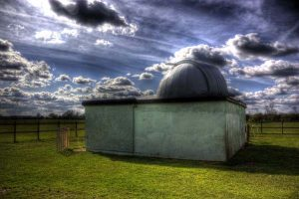
Who We Are
About Us:
  James Hannan – Chair, NEAS
  Clare Lauwerys – Secretary, NEAS
  Ian Lauwerys – Member, NEAS
About NEAS:
  Covers North Essex: Chelmsford, Colchester, Braintree, Etc.
  We cater for a wide range of experience and interests from beginner upwards
  Main emphasis on visual observing and events for members and public
  Members have use of a full-sized observatory in a rural location
  Extensive outreach programme popular with public and fun for members
Notes:
JAMIE
Introduce selves
NEAS has a large membership, 200+ members, core of perhaps 30-40 very active members.
Mainly visual observing, although interest and skills in imaging has grown in past year.
Society has some experts in particular areas, but organised scientific work not something we do at present.
Public outreach forms an important part of what we do, with many of the more active members supporting multiple events each month.

Slide 3
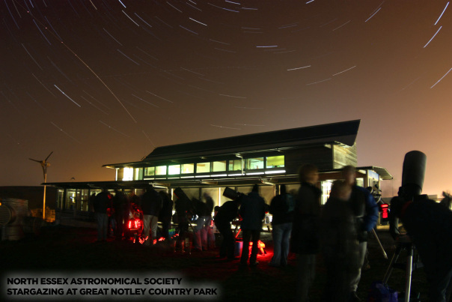
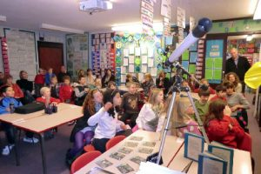
Pre-Lockdown Activities
Weekly observatory meetings for members
Public talk by external speakers monthly
Public stargazing events twice per month
Young Astronomers Club
  Programme of talks and activities for primary schools
  Monthly meeting for public & members 7-11 & 11-17 years
Outreach
  Talks and observing for schools, youth organisations, etc.
Notes:
JAMIE
- Weekly observatory meetings for members; typically 5 to 10 members. Casual observing, teaching new members the ropes of equipment and the sky, etc.
Public talk by external speakers monthly; typically 30+ attendees, members and non-members.
Public stargazing events twice per month; typically 100 to 200 attendees across both events.
Young Astronomers Club
Programme of talks and activities for primary schools; usually two schools in progress across one-term programme weekly.
Monthly meeting for public & members 7-11 & 11-17 years; typically a dozen attendees.
Outreach
Talks and observing for schools, youth organisations, etc. Varies but typically 1 to 2 events per week through winter months.

Slide 4
Post-Lockdown Panic!
18th March – All face-to-face activities cancelled
Priority 1:
  Focus on existing membership and keeping NEAS alive
  200 members pay subscriptions, need to give them something in return
  Without members there is no society
Priority 2:
  Keep public engaged in hope of restarting face-to-face events eventually
  Gain new members as people looking for hobbies they can do from home
  Do public good during time of national/global crisis
Notes:
JAMIE
All face to face activities cancelled on 18th March.
Quickly realised we would have to do something to keep the society going.
Major focus has been the existing membership, without them there is no society and they are paying membership subscriptions so need to do something in return.
This has been largely successful, most members have renewed with only a small amount of churn as we see every year.
We have also tried to keep the public engaged:
Having spent a couple of years successfully building a following and growing our outreach events, we did not want to lose momentum and have to start from scratch when back to normal.
Became clear that many people needed new hobbies during the lockdown, and astronomy is an ideal choice as can be done from home with minimal equipment.
Felt that we should do our bit and try to spread some public good as this is a core aim in our constitution.

Slide 5

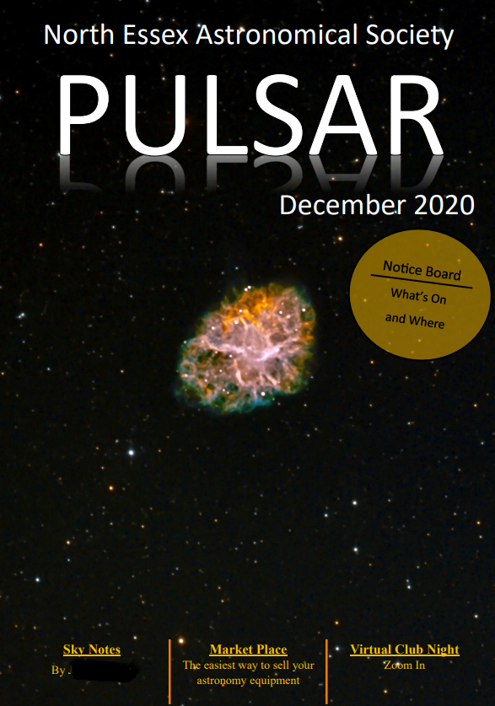
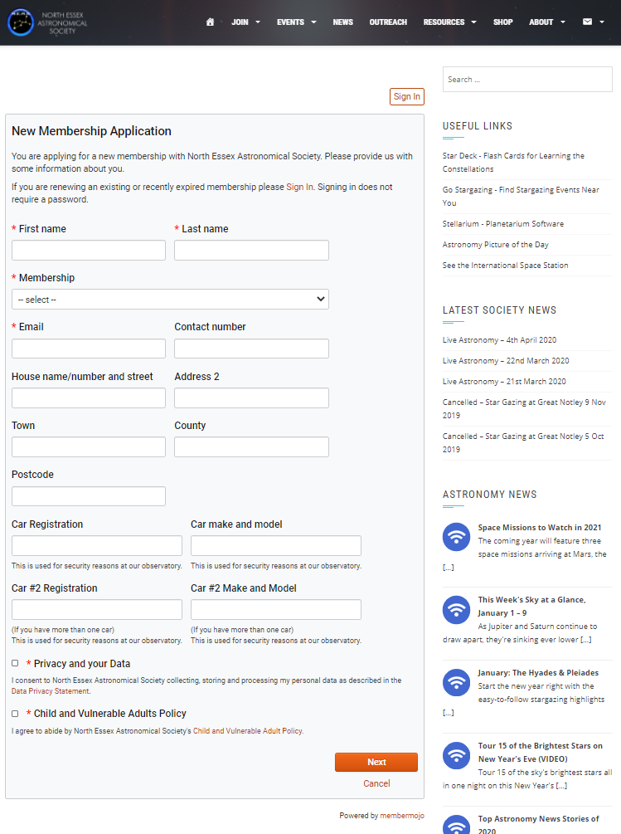

Challenge 1 - How to Keep In Touch?
Already had good communication channels:
  Weekly email newsletter to all members, plus private Facebook group for some
  Monthly magazine for members by email (“Pulsar”)
  Very active public Facebook page, 2,500+ followers, plus Twitter & mailing list
  Good web site to support/reinforce messages
  Online membership system – join, renew and pay via web site and MemberMojo
Less good channels:
  WhatsApp – OK for one-to-one chats and very small groups, unproductive for larger discussions
  Facebook Messenger – Similar problems to WhatsApp, not as widely used
Notes:
CLARE
Looking back at our journey through 2020 there is a risk that what we are presenting seems very organised and methodically planned.
The reality is far from that; we tried different things based on who was willing/able to get involved and took forward those that worked best.
Nonetheless it is fair to say that what we have achieved wasn’t by complete accident.
NEAS has always focused on public outreach and we have become more organised and professional at it over the past three or four years driven by the committee and a number of individuals who devote the majority of their spare time to it.
Thus we were in a pretty strong position right from the start of the crisis.
Our first problem was keeping in touch with both the membership and with the public, and this is where the past few years effort have really paid off.
For the members:
We have a weekly email newsletter that goes out to every member. This summarises upcoming activities and was a great channel for advising people how to join in with our new online activities.
We also have a monthly email magazine with more in-depth articles written by members.
We have a members-only Facebook group which is quite active, but we are careful to ensure that this isn’t the primary communications channel as it would exclude a lot of the membership otherwise.
In terms of public engagement:
We have an active Facebook page with 2,500 followers. We post links to interesting articles, images, etc. regularly to engage people, and it is one of our primary ways of getting people to our public outreach events.
We also share some of the same material via Twitter, though this is less important. Our social media following didn’t happen overnight and has been grown over many years, so don’t despair or expect miracles if you’re just starting out.
We have a small mailing list which we occasionally use, and should probably make more effort with to be honest.
We have a good web site with well organised information about who we are and our events.
Very importantly, we moved to an online membership system (MemberMojo) a few years ago. This allows people to join, renew and pay subs online immediately:
Since we moved away from slow manual processes, we have seen membership more than double and we’re convinced that the ease of renewing has helped us to retain members this year that we would otherwise have lost.
People are much more likely to fill in an online form and make a PayPal payment or bank transfer than they are to print a paper form and post it with a cheque.
The barrier to becoming a member is very low as a result, and we have seen new members join throughout 2020, in some periods perhaps one or two a week.
We have used other communication channels that are less satisfactory:
WhatsApp can be helpful for individuals to keep in touch one-to-one, and for small groups (a handful at a time) to organise things, but larger groups have proved unproductive as there’s not really a discussion going on but multiple threads of discussion, interjection and a lack of clarity about what the objective is or when a consensus or decision has been reached.
Similarly we have used Facebook Messenger to organise volunteers for public events in the past – it can be helpful if deciding whether to go ahead with a weather-dependent event, etc. but otherwise has similar issues to WhatsApp, etc.

Slide 6
Communicating Effectively
In order to make best use of our channels, our communications are:
Structured
  We know the audience for each channel
  We make it clear what people need to do with the information, how and when
  We speak as ‘The voice of the society’
Regular
  Communications go out on the same day/date without fail
Frequent
  We update social media often – at least four times a week
Notes:
CLARE
- OK so we had a number of established and functional communications channels, but how to make best use of them?
The key take-away for us (both pre-crisis and since) is that communications via these channels needs to be well organised.
Structured
Work out who your audience is for each communication.
What information do you want them to gain and what actions do you want them to take – signpost the next steps very clearly.
Comms are funnelled via the Secretary, not as a barrier, but to ensure consistency and a ‘professional’ tone.
Due to our size, we speak as “The voice of the society”; whilst it can be helpful for comms to appear from named individuals in some channels to humanise things, the tone of our content is ‘on brand’ and not personal.
This may be different for a much smaller society of course, but as we have grown we feel it is important not to appear as ‘us’ (committee and other insiders) and ‘them’ (less active and newer members for example).
Regular
We send particular communications on a tight schedule; e.g. the email newsletter goes out every Monday without fail. If information misses the boat, it waits until the next week unless it is critical (e.g. last minute change of plans).
If people are expecting a communication every week or month, they tend to give it more attention than if it arrives at random intervals.
Frequent
This is particularly important for public engagement via social media.
Whilst we are not a corporation with a fixed schedule and planned series of posts/updates, we do try to post something at least four times a week at minimum.
This drives engagement which in turn makes it more likely that the social media platforms will show our content to more people.
We haven’t had to resort to paid advertising via social media ourselves, but it is worth bearing in mind that done properly it is a relatively cheap way to reach large numbers of relevant people quickly if you are starting from zero.

Slide 7
Challenge 2 – Face-To-Face with Members
Clearly needed a video channel but which?
  Fortunately Ian had experience in corporate IT – Zoom, Teams, Etc.
  Zoom considered best - low cost, simple, reliable and functional
  Trialled free version – first virtual club night 2nd April 2020
  Purchased monthly “Pro” Plan then Switched to annual “Pro” Plan
Alternatives ruled out:
  Skype – long used, but unreliable and needs to be installed, registered for, etc.
  Microsoft Teams – missed the boat with public, user experience worse than Zoom
  Google Meet, Facebook Rooms, etc. – not universally used, late to party
Notes:
IAN
Whilst the subject of this talk is ‘Outreach’, we make no apologies for including our own membership in this as most of the lessons are equally applicable.
We have a core of perhaps 40 members who are quite active, but the other 160 are just as important, and keeping them engaged is a similar problem to public outreach.
It might be tempting to think that the onus is on them to get involved, but we are a friendly and open society with many casual members and the committee and others feel strongly that we have to try to engage them.
So our second problem was how to replace the face-to-face activities that had previously been the glue holding the society together.
With hindsight it might seem obvious that a video chat solution would be the way forward, but if you’d said ‘Zoom’ back at the start of March, 90% of people would have given you a funny look!
Fortunately we had a number of tech-savvy members who were comfortable using video chat with friends and family and in work environments.
Ian in particular had many years of experience running corporate IT departments and had come across pretty much every conferencing system out there, most of them complicated and unreliable!
He considered Zoom to be a great option as it had been gaining ground in the corporate world for many years prior, but was really taking off throughout 2019.
For non-corporate use, the advantage was that it was free to start with, simple to set up and use (no need to even have members register for accounts), reliable and functional compared to the alternatives and worked on all devices and operating systems.
We held our first ‘virtual club night’ on the 2nd of April 2020 and by the end of April, Zoom’s global usage had jumped 30-fold from the start of the month, so we were in on the ground floor as it were.
The virtual club nights proved very popular, especially during the first lockdown so the committee immediately agreed to move to a paid ‘Pro’ plan to avoid the 40 minute restriction on meeting length.
Zoom did offer free unlimited meetings for the first few attempts to reel us in, and we overran 40 minutes every time.
We moved to an annual plan in July to save money once it became clear this crisis was going to run and run.
Whilst we didn’t have a formal discussion about alternatives to Zoom, those involved did rule out the others for good reasons:
Skype had been around for many years, but it is very unreliable in terms of call quality, with frequent sound and video glitches and call drops. Whilst it is free, it is only really suitable for small groups, it needs to be installed (with attendant troubleshooting) and people have to register accounts, etc.
Microsoft Teams is sort of Skype on Steroids, but it is even more complicated to register for as an individual (though easier for large public webinars, etc.) Bear in mind that at the start of the crisis, it was not unlimited or free with Microsoft being forced to play catch-up with Zoom since. Ask pretty much anyone who has to use Skype in a corporate environment and they’ll tell you they hate it and wish they could use Zoom instead.
Google Meet was not widely used and Facebook Rooms came late to the party as a response to Zoom, and again people need to register for accounts (which in the case of Facebook people know come with all sorts of privacy concerns).

Slide 8
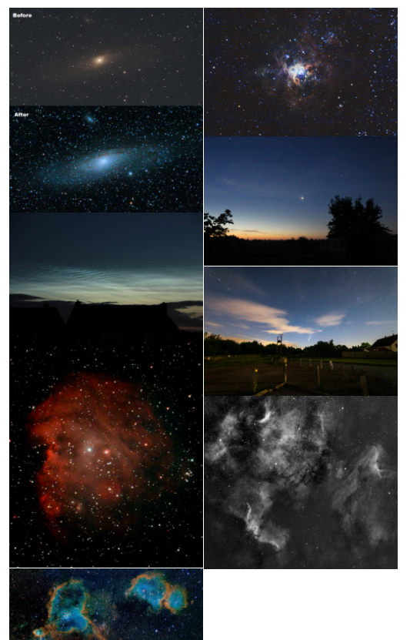
Types of Zoom Event
Weekly “Club Nights”
  Informal chat – a bit of astronomy, a lot of social discussion
  More formal committee meetings
The dreaded “Quiz Nights”
  Used free “Vevox” app/web site for questions and multiple choice answers
  See vevox.com
“Imaging Wednesdays”
  Coalition of the willing – very much self-help
  Have turned a number of beginners in to proficient imagers in nine months or so.
Working towards “Introduction to Astronomy”
Notes:
CLARE
With the membership we have used Zoom for three main types of event:
We have replaced our regular Thursday night at the observatory with an online ‘Club Night’.
This is an informal event without an agenda. People just turn up for a chat for an hour or two, sometimes longer.
There is a bit of discussion about astronomy, and if a new member joins, existing members do make an effort to engage them – ask about their experience, what they want to learn, offer help and advice and answer questions.
There is an awful lot of random social discussion across a wide variety of topics each week, everything from cake making, good TV shows, counting the snails in your garden by painting numbers on their shells, etc.
The meetings aren’t ‘chaired’ as such, but the society account which hosts the meeting is managed by a couple of individuals. Usually the only intervention required is to mute someone where they are having a side-chat with someone physically at their end and not realising they are preventing others from speaking/hearing.
We do have some fundamental standard of behaviour expected in our members in our constitution but fortunately our members are pretty aware of the different sensibilities of those in the Zoom meeting and respectful of the boundaries of appropriate behaviour.
During the brief interlude when it was possible to have limited attendance at our observatory (in line with Covid guidelines) we have run mixed online/in-person club night with the observatory attending the meeting.
This has allowed new members to get virtual tours of the observatory upon joining.
We also run committee meetings via Zoom, usually starting the Thursday club night a bit earlier with formal section so members can attend
We have run several of the dreaded ‘Zoom Quizzes’ through 2020, usually to replace the big social events in our calendar such as our annual Perseids meeting and our Christmas party.
These have actually proved very popular but we don’t run them too often as they take a lot of preparation and people do suffer ‘Quiz Fatigue’ as lots of people run them for friends and family.
They have been very worthwhile though as we’ve had lots of members attend who don’t take part in the other events we run online.
We use a free web site and app called vevox which allows the creation of a series of multiple choice questions for people to view and answer. It makes the logistics of running the quiz much easier and keeps track of scores.
We can get through about 60 questions in an hour and a half with plenty of time for breaks and interjections, and people have had great fun.
Towards the end of April there was a request from several members for help getting started with Astro-imaging.
We started an ‘Imaging Wednesdays’ group which meets most weeks.
This was deliberately structured as a ‘self-help’ group, not as a series of formal talks or masterclasses.
In reality a lot of the work running our online events falls on a small number of the ‘usual suspects’, and facilitating a self-help group reduces the workload and forces/encourages others to get involved.
We’ve turned a number of complete novices and beginners in to quite proficient imagers in the past nine months, largely through the power of encouragement, sharing stories and offering advice – no PowerPoint involved.
Following further requests from members, we are now working towards an “introduction to astronomy” group similar to the above.
We surveyed the membership and potential volunteers as to what they wanted or could do, how and when, etc. using Survey Monkey.
Clear it’s going to need a bit more preparation ahead of each meeting, but again trying to encourage more than ‘the usual suspects’ to get involved.

Slide 9
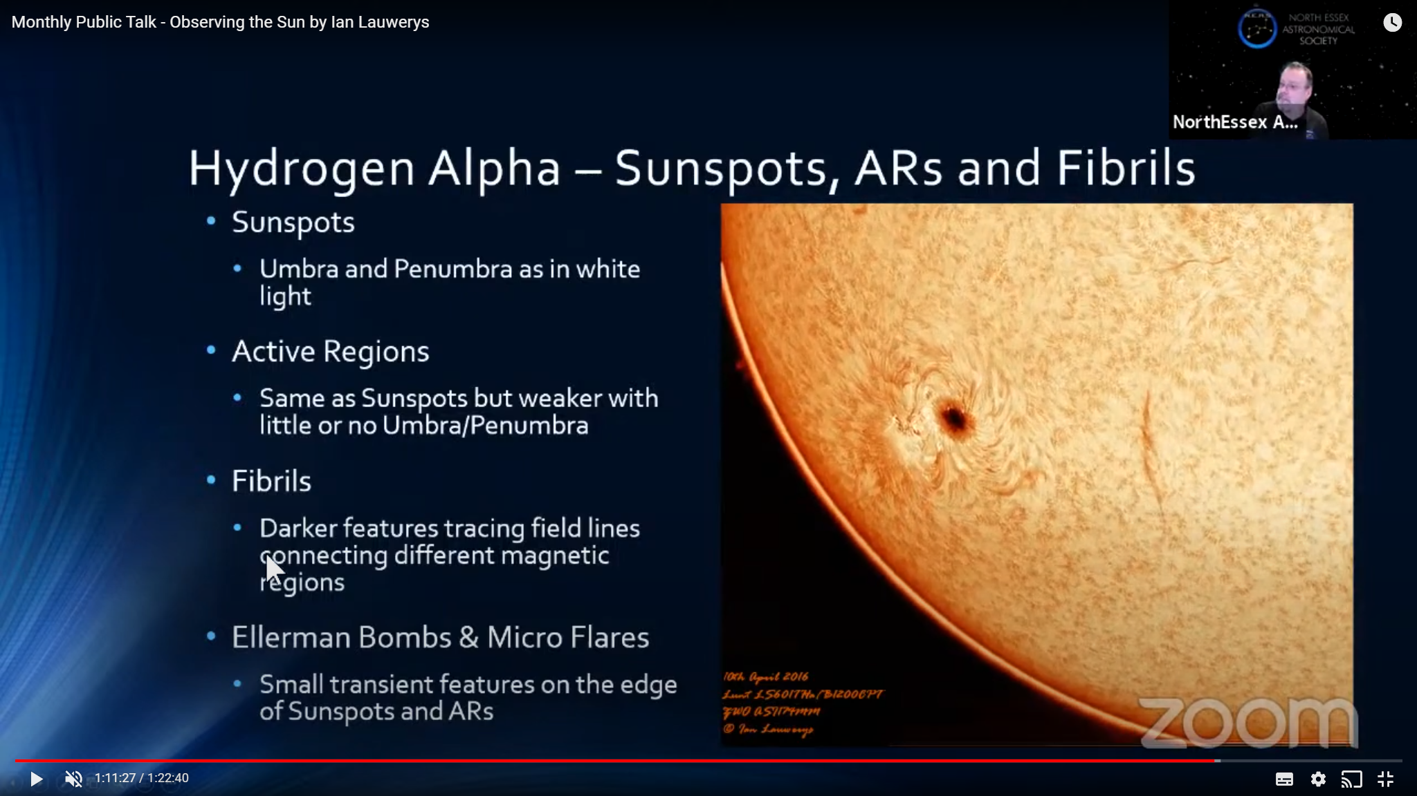
Challenge 3 – Outreach to Public
Needs platform for Public Outreach
  Ruled Only Zoom “Webinar” - Expensive for infrequent use
  Chose YouTube as no login/signup need by attendees
“Restream” Zoom meetings for events such as talks
  Simple to start PowerPoint Presentation and then use Zoom “Share Screen”
  15th April – Live monthly talk on Meteor Detecting to public via YouTube
  Held private members Q&A straight after via Zoom
  Several meetings since – practice with external speakers
  Always have “Plan B”.
Need to do more work on finding external speakers
Notes:
IAN
For public outreach we looked at our options for running events
We considered Zoom’s Webinar subscription but ruled it out as too expensive given that we were unlikely to run lots of events.
We had used both Facebook live and YouTube for previous live observing events.
We settled on YouTube as our primary route to the public as there is no cost, the public does not need to sign up, etc.
For events such as talks YouTube can work well in conjunction with our existing Zoom Pro subscription
The presenter simply needs to start presenting the PowerPoint on their screen and then use the Zoom “Share Screen” option to share the presentation (not the PowerPoint window)
The presenter will find it easier if they have a multi-monitor setup on their screen – alternatively the meeting host can share the PowerPoint, but then the presenter needs to use the by now familiar “Next Slide Please” instruction!
Members can attend the Zoom as normal, BUT they need to keep their microphones and video off to avoid appearing in the live stream – we briefed people in emails and at the start of the meeting before starting live stream – this is one place where Zoom Webinar is better
It is then possible to simultaneously stream the meeting to your YouTube channel
The process is a bit convoluted and this is coming from an IT professional
First you need to enable live streaming in your Zoom account’s settings (under “In Meeting (Advanced)” section).
Next you need to schedule a live stream for the appropriate date and time in your existing YouTube channel.
Then you need to schedule your Zoom meeting, and add the YouTube live stream details the ‘Live Streaming’ section that should appear at the bottom of the meeting details in your Zoom account.
One tip is to use the “Live (Custom Live Streaming Service)” settings rather than the specific “YouTube” settings
Finally when you have started your Zoom meeting, you go to “More” and select “Live On Custom Streaming Service” to start the actual stream on YouTube
My advice is to set up some practice YouTube live streams and Zoom meetings and rehearse until it works and you are confident on linking and starting/stopping scheduled Zoom meetings and Scheduled YouTube streams.
The process works well once you get it set up right, but it’s really not obvious or easy as to how to set it up.
Bear in mind that the YouTube live stream will always be many seconds behind the live Zoom meeting so wait a bit for your face to appear after starting the stream before your start speaking to be sure it is running.
If you have an assistant who can monitor both on a different device that will let you know when you have it right.
We have run several talks in 2020 via Zoom and also via Zoom and YouTube.
If you’re using a speaker who has not been through the process before, definitely ask them to rehearse with you ahead of time. We’ve attended some other events where the speak has struggled with the technology.
Always have a “Plan B” – we’ve only cancelled one event this year (due to speaker having an Internet outage), but another where the speaker was unable to attend last-minute.
A pre-recorded YouTube of the talk may be an option, or have a standby (member) speaker who can step in.
The one thing we haven’t done enough of is finding more external speakers.
At the start of the crisis we found many were reluctant to do online talks as they were unfamiliar with the technology or wanted to preserve their IP.

Slide 10
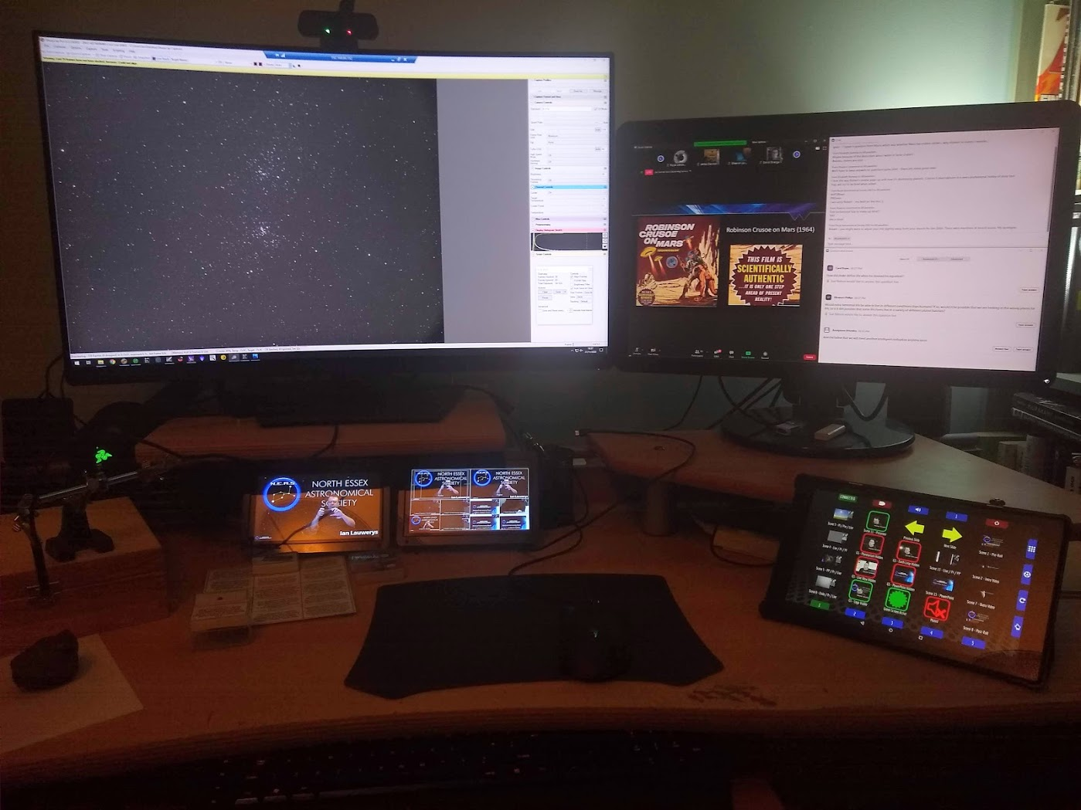
Other Technology for Live Observing
Webcam
Remote Control Of Observatory PC
Zoom Webinar
Can be as simple as “Share Screen” from computer hooked to camera/telescope
We use free “Open Broadcast Studio”
  Basically a TV studio on your desktop
  Capture video/sound from cameras, applications, pre-recorded segments, etc.
  Mix them in to “scenes” and switch seamlessly
Stream direct to YouTube, Facebook live, etc.
  Simultaneously record to PC for editing and re-publishing to other platforms
Or use output as a “virtual webcam” to feed in to Zoom
  Successfully used for two National Astronomy Week sessions via their Zoom Webinar
Open Broadcast Studio
Live Previews
Close-Up Cam
(Meteor Samples)
Stream Deck (Scenes,
Sound, Green Screen,
PowerPoint, etc.)
Notes:
IAN
We have also done live observing, again both streaming to YouTube directly and also via Zoom.
This can be done simply by running the Zoom Client on the PC that is connected to the camera and telescope and using the “Share Screen” option.
Alternatively it can be done more professionally using live streaming software.
There is a lot of this around primarily developed by/for video gamers to share their prowess online via YouTube and a streaming service called “Twitch”.
It may sound alien to us oldies, but it’s serious big business and a lot of money is being made outside the strictures of old-fashioned broadcast media.
The tool we use is called “Open Broadcast Studio”.
It is basically a free TV studio on your desktop.
You can capture multiple video and sound sources from webcams, applications running on your PC, remote control applications for your observatory PC, pre-recorded video segments, etc.
These are them mixed together in to pre-defined “Scenes” which can be switched between at the click of a mouse.
The current scene is then streamed to your choice of output.
Typically this is either directly to a streaming service such as YouTube or Facebook Live, or you can actually make OBS behave as a virtual webcam which can then be selected in your Zoom meeting.
I really wouldn’t underestimate the complexity of all this, especially if you are a one-person band.
Firstly you’ve got to be the presenter, speaking coherently and engagingly to the audience.
Secondly you’ve got to be an astronomer, driving your telescope and camera software to find and show interesting objects to best effect.
On top of that you’ve got to be your own broadcast technician, managing your stream, switching between scenes as the right time, turning on and off the green screen, etc.
It takes many hours to set up just the OBS side of things, assuming you already have a working imaging setup you can control remotely.
The result has been some pretty good live streams this year, including two sessions where we successfully participated in National Astronomy Week with other observers.
I have to say these were less stressful as the presentation team took care of a lot of stuff so we could focus just on finding and showing interesting objects.

Slide 11
Costs
Service | Cost
Web Site (Amazon Web Services & WordPress) | £100 per year
Zoom Meetings Pro (Annual Subscription 100 Participants) | £144 per year
MemberMojo (Membership System 101-500 Members ) | £75 per year
Vevox Free (Quizzes) | £free
YouTube Channel | £free
Facebook Page & Members Group | £free
Open Broadcast Studio, Updeck | £free
Sharpcap, Sequence Generator Pro, PHD Guiding (Live Observing) | £member’s own
PowerPoint (Talks) – Or use free alternative Google, Libre Office, etc. | £presenter’s own
SurveyMonkey, Google Jam, Google Sheets (Planning) | £free
Email (MailChimp, Gmail with MemberMojo) | £free
Notes:
CLARE
We had budget available as other costs not being incurred, e.g. Hire of hall for talks, speaker expenses, etc.
Most software and services we use are free or already owned by members or presenters
The few paid-for services we use have proved invaluable this year, and we are likely to continue with them even when the crisis is over.
Our total outlay on this technology as a society is just over £300 a year, which is a pretty small fraction of our annual budget.
Without it we wouldn’t have had a society to speak of during 2020.

Slide 12
Lessons We Have Learned
Coalition of the willing – let them get on with it
Keep in touch with your members/public audience
Start simple, lots of free / trial platforms
Plan and practice ahead of time if you’re unfamiliar/unsure
Always have a plan B for public events
Be persistent – not everyone will attend, not everything works
Be confident and have fun
Notes:
JAMIE
They lessons we have taken from 2020 are:
We have a coalition of the willing who will get stuck in (as do you we suspect).
Let them get on with a little oversight rather than trying to run everything through endless committee meetings.
Keep in touch with your members and your public audience. There is always something interesting to say, and even reminding them you still exist is better than radio silence.
If you haven’t done much online yet, start simple, low risk and low cost. There are lots of free trials and low-commitment services – see what works for you by doing rather than over-thinking.
For larger/more public events, have a written plan, share it and practice ahead of time.
Always have a “Plan B” for public events, even if it’s just a re-run of a YouTube you did in the past.
Be persistent – accept there will be some naysayers and not everyone has the appetite or time to attend your events.
Accept that not everything you do will be a complete success – learn from your failures but don’t let fear of failure hold you back.
Be confident and have fun – the next generation of amateur astronomers are already out there and active on social media. You need to grasp this opportunity in order to stay relevant to them.

Slide 13
Thank You
Questions?
Notes:
ALL

